Slide 1

Capstone Project -2
Bike sharing Demand Prediction
Submitted By:
Jyoti Singh

Slide 2

Problem Statement
Currently Rental bikes are introduced in many urban cities for the enhancement of mobility comfort. It is important to make the rental bike available and accessible to the public at the right time as it lessens the waiting time.
It is important to make rental bikes available and accessible to customers at the right time as it lessens the waiting time, eventually, providing the city with a stable supply of rental bikes.
Predicting the important features related to the availability of rental bikes.
The goal of this project is to build a ML model that is able to predict the demand of rental bikes in the city of Seoul.

Slide 3

Objectives
Primary Objective: To Build a superior statistical model to predict the number of bicycle that can be rented with availability of data
Secondary objectives:
To learn how real time data is represented in dataset
To understand how to preprocess such data
To fit various models such as Regression, Regularized regression(Lasso, ridge and Elastic Net), Decision Tree, Random Forest ,XGBoost, Light GBM

Slide 4

Proposed Methodology
Clean data
Fetch and analyzed data
Building a prediction model
Validate the model
Predict values for the test data
Remove Missing Data
Create new features
Split Data

Slide 5


Data Description
The dataset contains 8760 rows and 14 columns,below are the features details:
Data | Data Type | Description
datetime | Object | From Dec 2017 to Nov 2018
Rented Bike count | Integer | The total number of bikes share for the hour
Hour | Integer | Per hour information
Temperature | Float | Temperature in degree celsius
Humidity | Integer | Relative humidity percentage
Wind speed | Float | The speed that air is moving in Meter/sec
Visibility | Integer | Visibility upto 10m

Slide 6
Data Description (Contd.)
Data | Data Type | Description
Dew Point Temperature | Float | Dew point temperature in degree celsius
Solar Radiation | Float | Solar radiation in Megajoules per square meter
Rainfall | Float | Rainfall in mm
Snowfall | Float | Snowfall in cm
Seasons | Object | Categorical (spring, Summer, autumn,winter)
Holiday | Object | Holiday /no holiday
Functional Day | Object | yes/no

Slide 7

Pre Processing and Data Cleaning
Duplicates Value: We searched for duplicates value but there were none duplicates in dataset.
Null Values: There were no null values in dataset
Convert column to appropriate data type: converted date column to datetime object
Extract new columns: Extracted day,month, year from date column
Drop Column: dropped unnecessary column
One hot encoding: Created dummy variables for season,
Replace the object values into 0,1 in the columns holiday, functioning day.

Slide 8
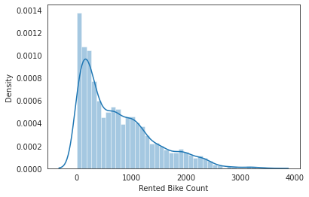
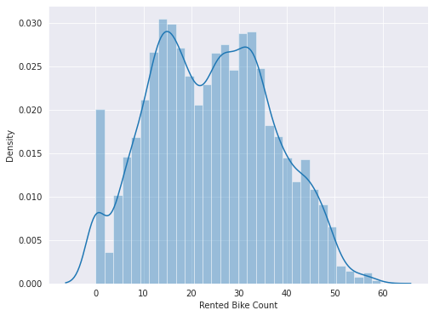
Exploratory Data Analysis
Skewness: Target variable (Rented bike count) is positively skewed
Before Transformation
After Square Root Transformation

Slide 9
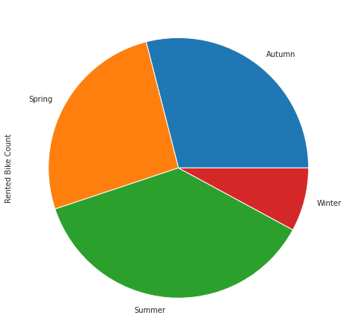
Rented bike count as per seasons
As we can see most of the bikes rented on the summer season and least number of bikes rented in the winter season
Business should keep in mind that there is enough availability of bikes in the summer season

Slide 10
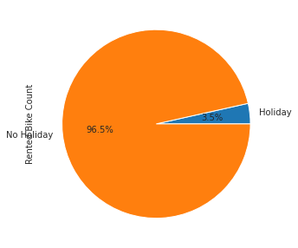
Rented bike count as per Holiday
As we can see most of the bikes rented on the working days.
Business should keep in mind that there is enough availability of bikes in working days.

Slide 11
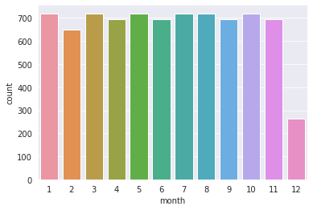
Rented bikes in different months in the year 2018
The plot shows that very less bikes have been rented in december which is winter season.

Slide 12
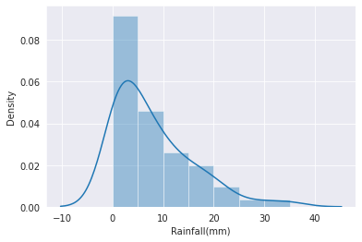
Bikes rented in different intensities rainfall
Plot shows that people tend to rent bikes when there is no or less rainfall.

Slide 13
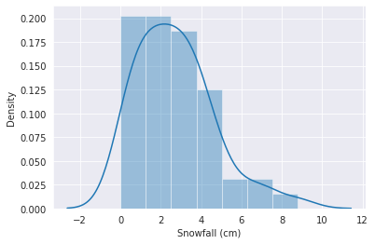
Bikes rented in different intensities snowfall
Plot shows that people tend to rent bikes when there is no or less snowfall.

Slide 14
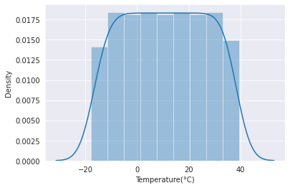
Bike rentals according to temperature intensity
Plot shows that people tend to rent bikes when the temperature is between -5 to 25 degrees.

Slide 15
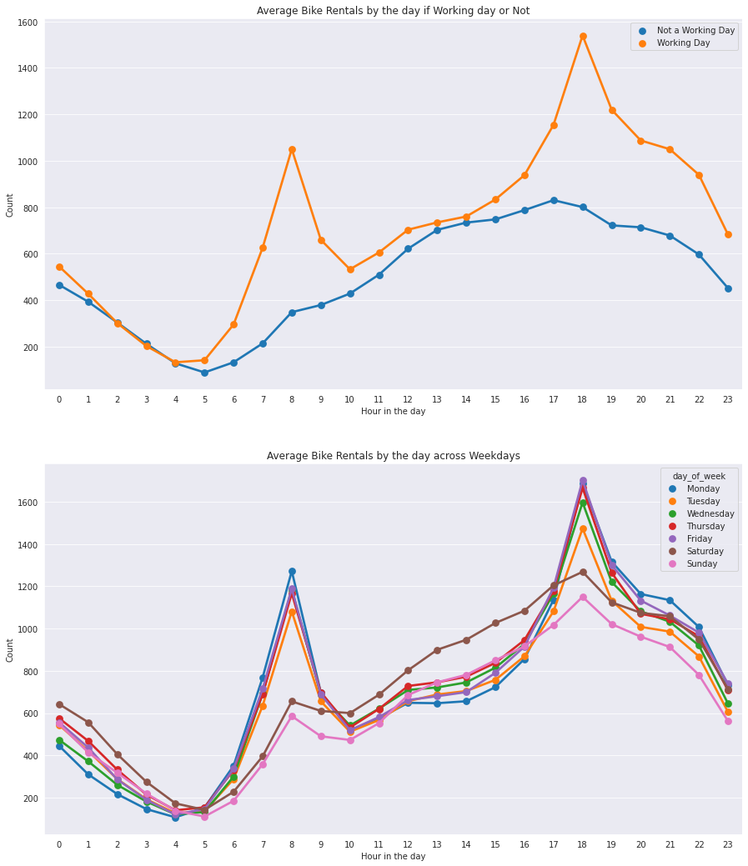
We see 2 rental patterns across the day in bike rentals count - first for a Working Day where the rental count high at peak office hours (8am and 5pm) and the second for a Non-working day where rental count is more or less uniform across the day with a peak at around noon.
Bike rental count is mostly correlated with the time of the day. As indicated above, the count reaches a high point during peak hours on a working day and is mostly uniform during the day on a non-working day.

Slide 16
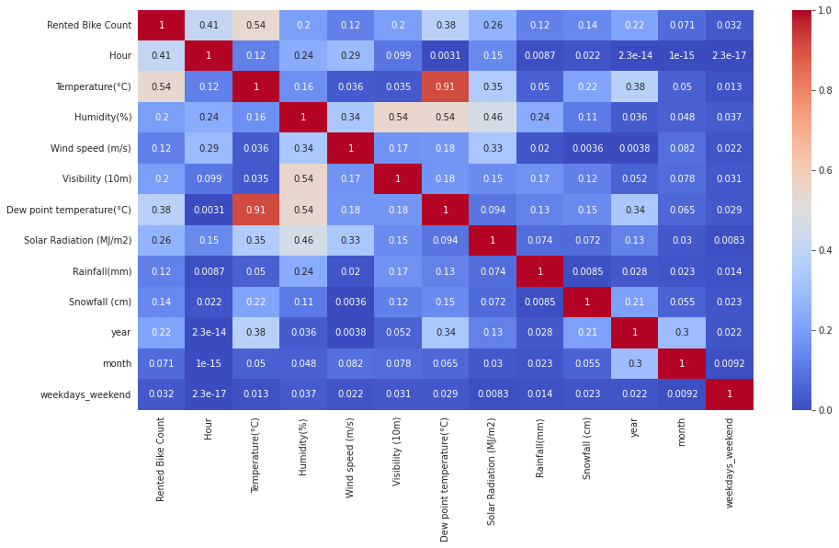
Correlation among the features
There is high correlation between temperature and dew point temperature.
To remove collinearity, used VIF.

Slide 17
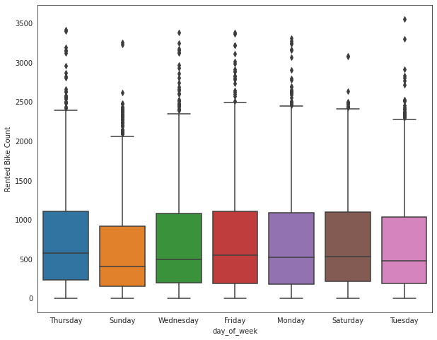
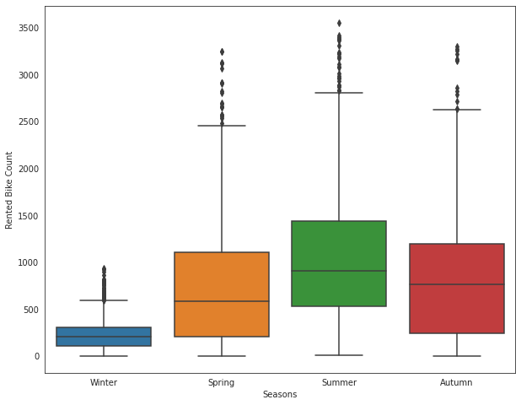
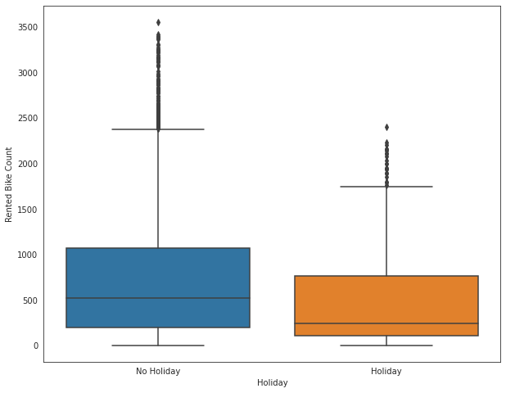
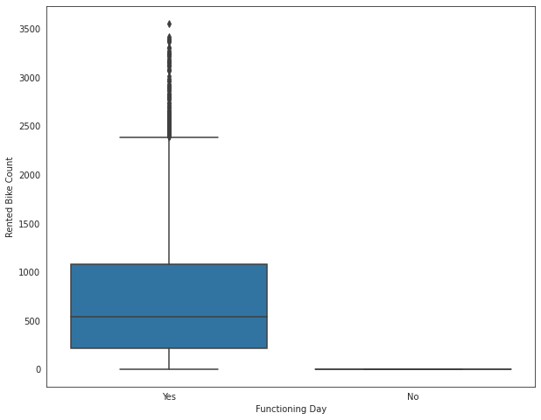
Relation between Categorical and Target Variable
There are outliers in the data so we have removed them using IQR

Slide 18
Modelling Approach
• Since the data contains outliers, and many categorical attributes. It won’t be wise to fit linear models, but we will fit the linear one and check errors.
• We will also use tree models, since they can handle outliers and categorical attributes better than linear models.
• We will use decision tree as a baseline model.
• Subsequently, to get better predictions, we will use ensemble models: Random forests, XGBoost, Light GBM.
• Final choice of model will depend on whether interpretability or accuracy is important to the stakeholders.

Slide 19

Fitting various model
Linear Regression
Lasso Regression
Ridge Regression
Elastic Net Regression
Decision Tree
Random Forest
XGBoost
Light GBM

Slide 20
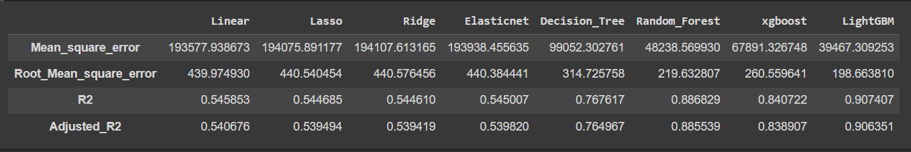
Model Performance Comparison
• The RMSE of Light GBM is least among all the models.
• The R2 score is also the highest in Light GBM.
It indicates that Light GBM is performing best among all the other models.

Slide 21
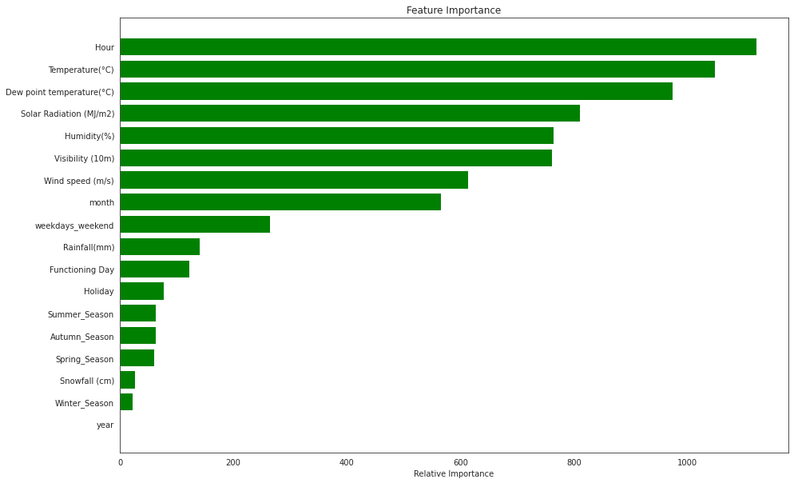
Feature Importance
Hour of the day is most important features which helping to make our prediction.

Slide 22

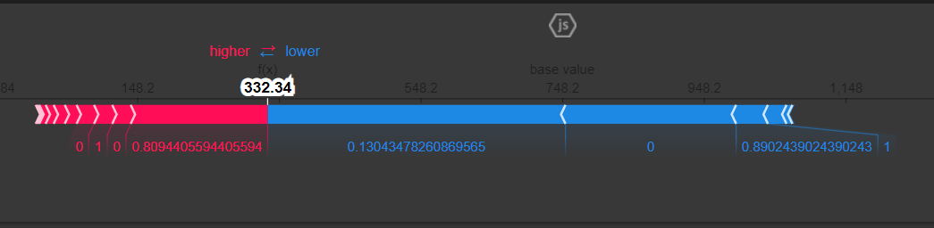
Model Explainability
The force plot is another way to see the effect each feature has on the prediction, for a given observation.
In this plot the positive SHAP values are displayed on the left side and the negative on the right side, as if competing against each other.
The highlighted value is the prediction for that observation.

Slide 23

Challenges Faced
● Comprehending the problem statement, and understanding the business implications.
● Feature engineering – deciding on which features to be dropped / kept / transformed
● Choosing the best visualization to show the trends among different features clearly in
the EDA phase
● Deciding on how to handle outliers
● Choosing the ML models to make predictions
● Deciding the evaluation metric to evaluate the models
● Choosing the best hyperparameters, which prevents overfitting
● Comprehending the problem statement, and understanding the

Slide 24

We used 6 Regression Models to predict the bike rental count at any hour of the day - Linear Regression, Ridge, Lasso, Random Forest,XG Boost and LightGBM Model.
Below is a summary of the model performances :
Of all the models, we found LightGBM Model providing the best/lowest RMSE score and highest R^2 score.
Hour of the day is the most important feature in the respect of all independent feature which provide highest bike rented count.
Thus, we have successfully built predictive models that can predict the demand for rental bikes based on different weather conditions and all other features.
If the model interpretability is important to the stakeholders, we can choose deploy the Light GBM model.

Slide 25


